Slide 1

FOOTBALL TOURNAMENT WINNER PREDICTION
Name-Kunal Kiran Bhoite
Student ID-20000769
Course-Master’s in Business Analytics

Slide 2

Aim
This research project aims to utilize historical data from diverse women's football tournaments and employ machine learning algorithms to develop predictive models to forecast the tournament winners. The project intends to contribute to the advancement of predictive analytics within sports by showcasing the efficacy of machine learning methodologies in anticipating the outcomes of women's fifa world cup.
T

Slide 3
Research Questions
How effective are machine learning models in predicting the winners of women's fifa world cup based on historical match data compared to random selection?
Which machine learning algorithm, among XGBoost, Logistic Regression, Support Vector Machine (SVM), and Gaussian Naïve Bayes performs best in predicting match outcomes for women's fifa world cup?

Slide 4
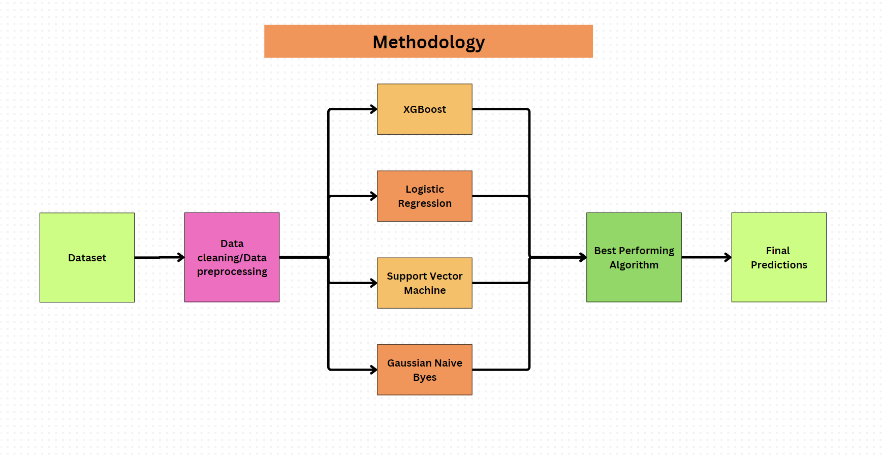
Methodology

Slide 5
Dataset
We have obtained a Women's World Cup history dataset from Kaggle.com. Here are the details of the dataset:
Home_team : Name of the home team
Away team: Name of the opposing team
Home_score : Goals scored by the home team
Away_score : Goals scored by the away team
Hometeam_rank : International ranking of the home team
Awayteam_rank : International ranking of the away team
Tournament : Name of the tournament being played
Continent : Continent where the match is taking place
Country : Country where the match is taking place
City : City where the match is taking place
Neutral : Indicates whether the venue is neutral or not
Day, Month, Year : Date of the match
MaximumTemp_Month : Maximum temperature of the month
MinimumTemp_Month : Minimum temperature of the month
MatchResult: Winner of the match (home team or away team)

Slide 6
Data Preprocessing/Data Cleaning
Load the Data: Read the dataset from a CSV file.
Handle Missing Values: Fill or drop missing values.
Remove Duplicates: Ensure no duplicate records are present.
Convert Data Types: Ensure that the columns are of appropriate data types.
Encode Categorical Variables: Convert categorical columns into numerical representations.
Scale Numerical Features: Standardize numerical features.
Split the Data: Split the dataset into training and testing sets.

Slide 7
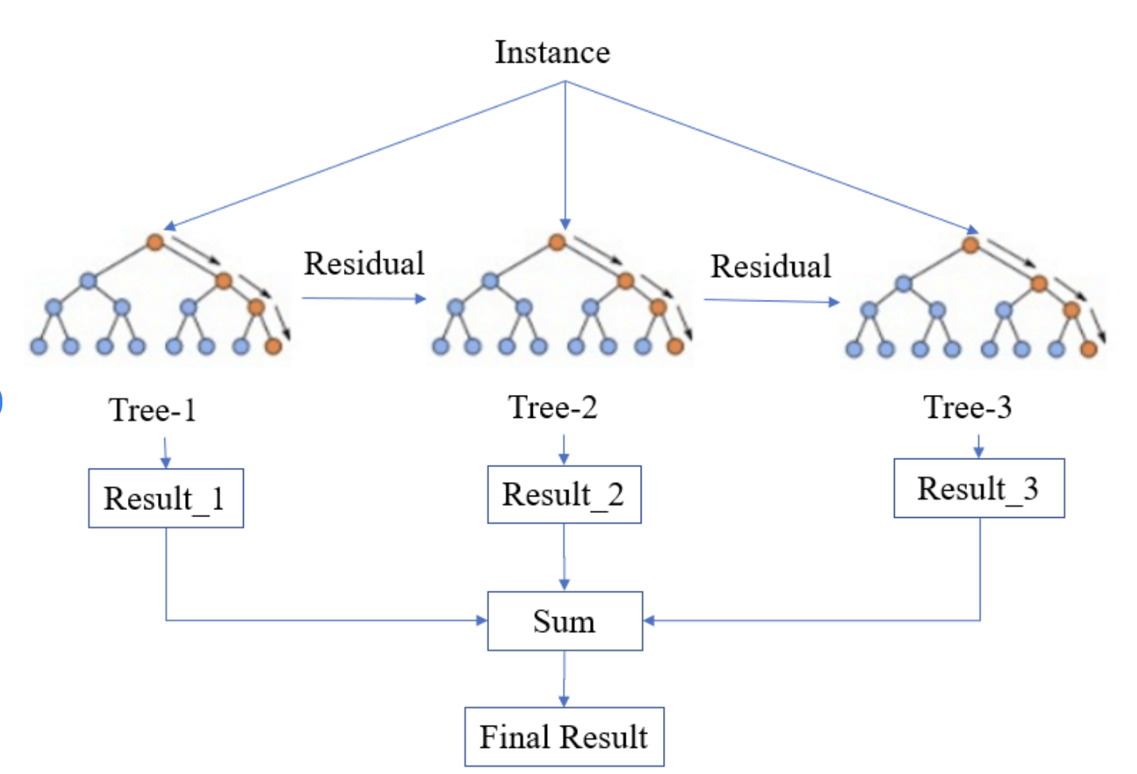
XGBOOST
Boosting is a technique that builds models sequentially. Each new model tries to correct the errors made by the previous ones.
In gradient boosting, each new model is created to reduce the errors of the previous models by looking at the gradient (direction and rate of the steepest ascent or descent) of the error function.
Start with an initial prediction, often the mean of the target variable.
Calculate the difference between the actual target values and the predicted values (residuals).
Train a decision tree on the residuals to predict the errors of the previous model.
Repeat steps 2-4 for a specified number of trees or until the residuals are minimized.

Slide 8
Logistic Regression
It uses a linear combination of input features, applies the sigmoid function to output probabilities, and classifies instances based on a threshold. The training process involves optimizing the weights to minimize the cost function using gradient descent.
Combine input features using weights to create a linear function.
Apply the logistic function to the linear combination to get probabilities.
Classify instances based on the probability, using a threshold (typically 0.5).

Slide 9
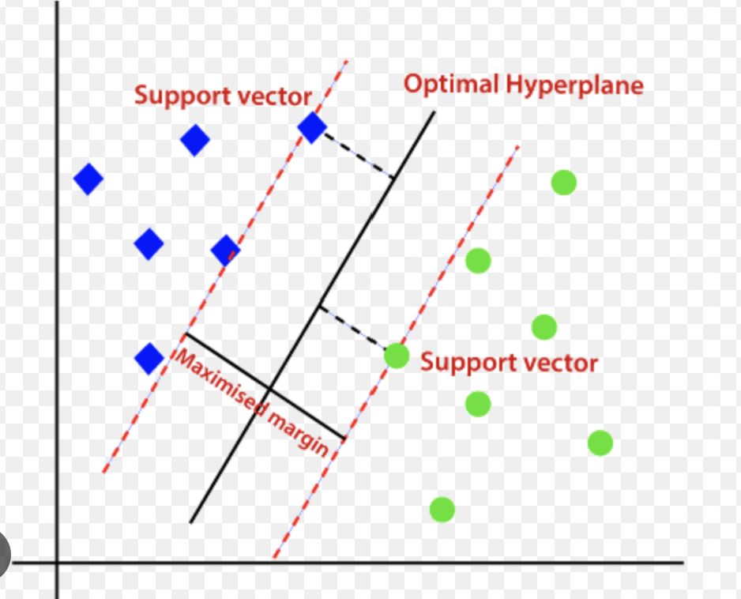
SVM
Support Vector Classifier (SVC) works by finding the hyperplane that best separates the data into different classes. It uses support vectors and margins to create an optimal decision boundary. For non-linear data, SVC employs kernel functions to transform the data into a higher-dimensional space where a linear separation is possible. This combination of linear separation and kernel trick makes SVC a versatile tool for various classification problems.
Linear Separability : If the data can be separated linearly, SVC finds the optimal hyperplane that maximizes the margin between the two classes.
2. Non-Linear Data : For non-linearly separable data, SVC uses kernel functions to transform the data into a higher-dimensional space where a linear separation is possible.

Slide 10
Gaussian Naïve Bayes
It leverages the naive assumption of feature independence and uses Bayes' Theorem to compute the probabilities of each class, making predictions based on these probabilitiesThe algorithm is based on Bayes' Theorem, which calculates the probability of a class given a feature set.
It Assumes that the features are independent given the class. This simplifies the computation.
It Assumes that the continuous features follow a Gaussian distribution.
Calculate Prior Probabilities : The probability of each class in the dataset.
Calculate Likelihood : For each feature, compute the probability of the feature value given the class, using the Gaussian distribution.
Calculate Posterior Probabilities : Using Bayes' Theorem, compute the posterior probability for each class.
Make Predictions : The class with the highest posterior probability is the predicted class.

Slide 11
Flask Framework
Flask is a lightweight and flexible web framework for Python. It is designed to make getting started quick and easy, with the ability to scale up to complex applications.
Simplicity: Flask is easy to set up and requires minimal code.
Flexibility: It doesn't enforce any dependencies or project layout, giving developers freedom to structure their projects as they like.
Modular: Components like routing, templating, and database integration can be added as needed through extensions.
Built-in Development Server: Flask includes a development server with debugging capabilities.

Slide 12
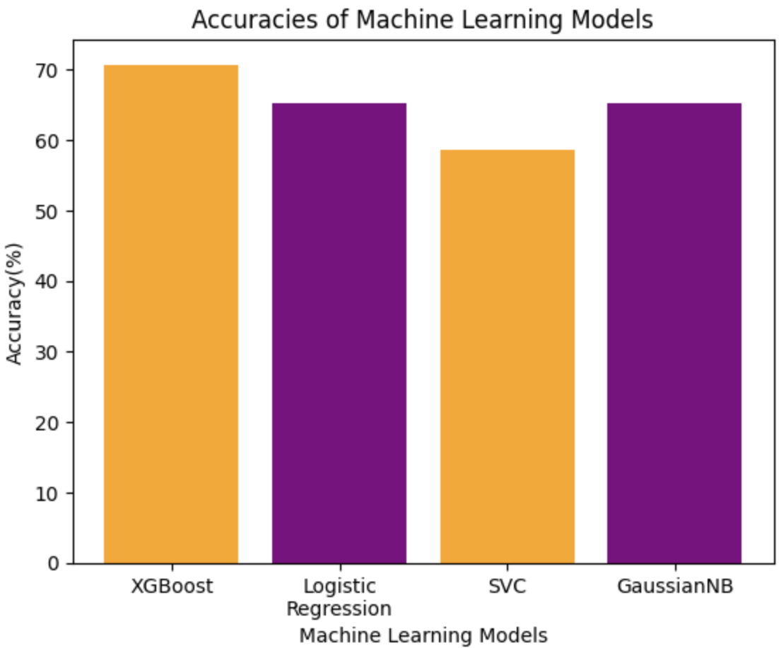
Results
XGBoost algorithm achieves an accuracy score of 70.80% in predicting winner of women’s football worldcup comparing that to random selection where accuracy of correctly predicting the winner would be approx 33.33% (win,lose,draw).
The XGBoost algorithm demonstrates the highest accuracy among the four classification algorithm.
Algorithm | Accuracy | Precision | Recall | F1
XGBoost | 0.708 | 0.696 | 0.757 | 0.696
Logistic Regression | 0.689 | 0.640 | 0.730 | 0.680
Gaussian NB | 0.651 | 0.556 | 0.720 | 0.610
SVM | 0.585 | 0.630 | 0.560 | 0.590

Slide 13
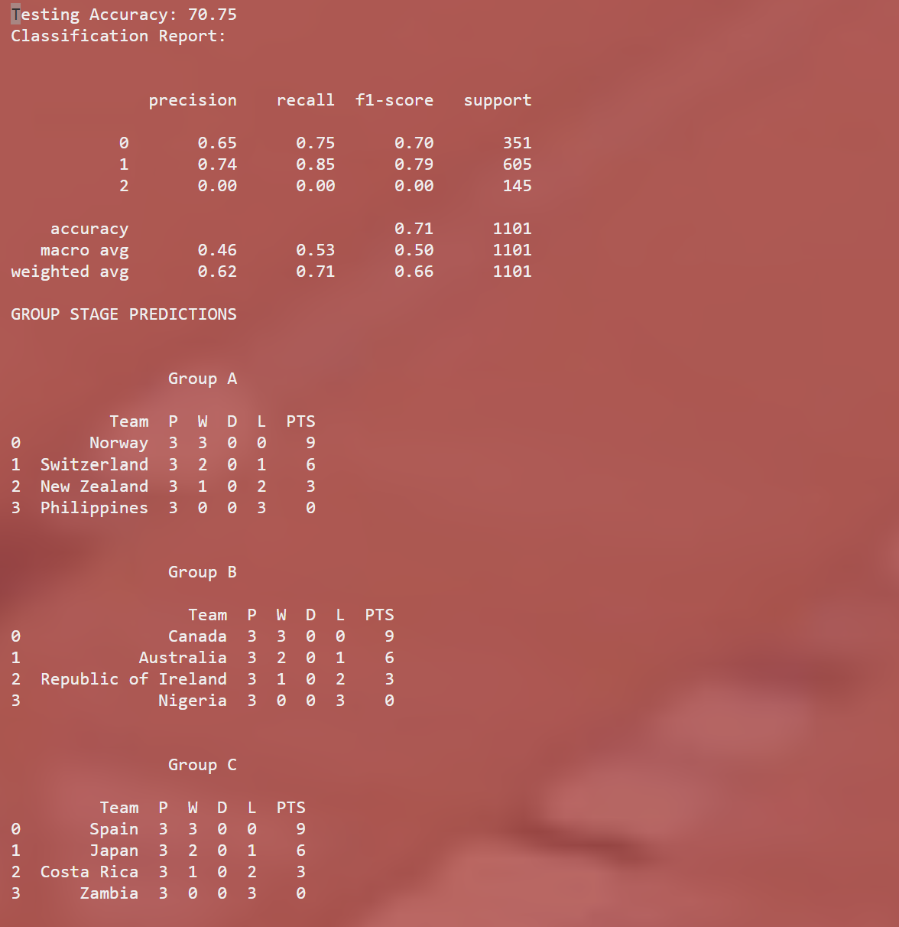

App Interface
Output
Input

Slide 14
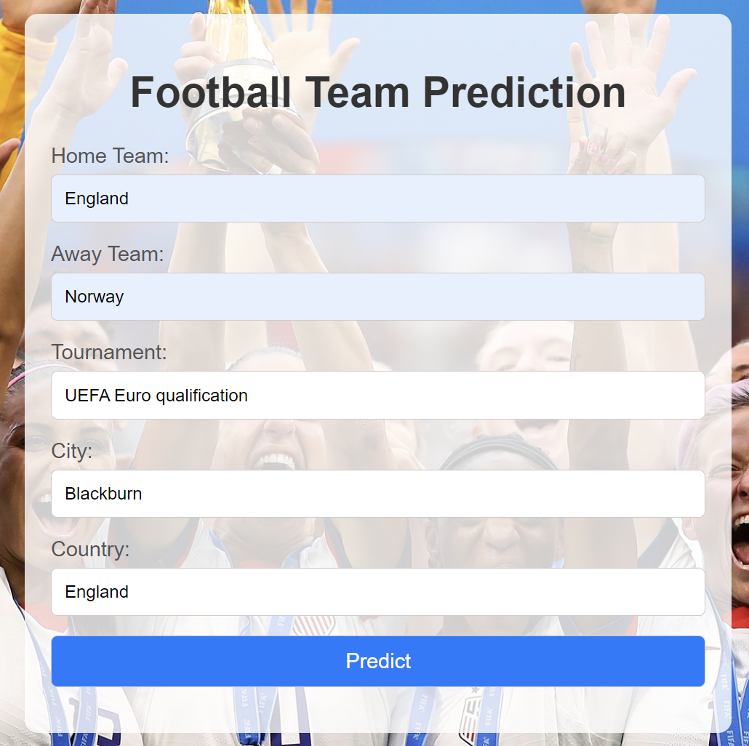
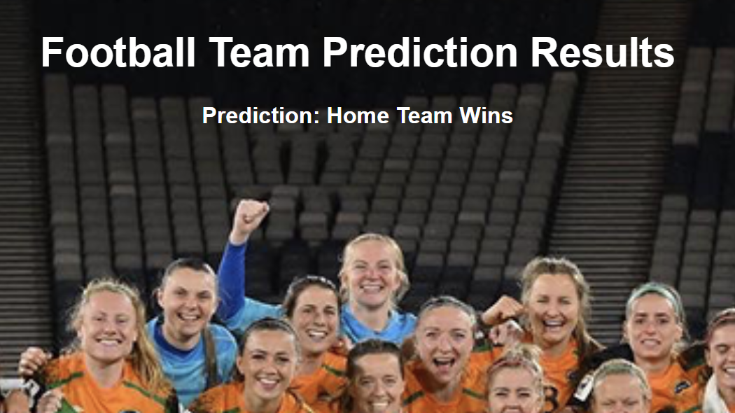
App Interface
Input
Output

Slide 15

Thank You!

